Slide 1
WELCOME
Drought Leadership Training
Virtual Training #2: Risk Management
February 10, 2022

Slide 2
HOUSEKEEPING
Internet connections can be good or bad. If you have a bad connection, remember that the presentation will be recorded for later viewing.
‘Zoom Bombing,’ or someone joining a meeting to share inappropriate materials, has been an issue in some video conferencing events like this. If this happens, we’ll shut down the meeting and send you a new link.
You will be kept muted until discussion times. .
We encourage you to ask questions through the Chat feature at the bottom of your screen; the host will be able to see these questions and will curate them for the presenter.
If you cause issues, you will be removed from the events.

Slide 3
HOUSEKEEPING
If you would like to make yourself anonymous please change your name here on zoom to “...”.
During polls answers will automatically be anonymous
You can go back and forth between anonymous and your name in the chat.
Rename yourself by clicking the “...” the box with your name (and picture if you have one). Click on 'rename', a box will appear with your name. Delete or backspace over the letters and type ...
Please text Micaela @ 970-584-7156 if you are having any difficulties or troubles!

Slide 4
Continuing Education Credits
Crop Advisors & Society for Range Management
Retta will be sending you an email regarding CE credits. If you have questions email retta.bruegger@colostate.edu.

Slide 5
ABOUT US
Drought Advisors is a partnership among:
Colorado State University Extension
Rocky Mountain Farmers Union
Colorado Water Conservation Board
The Ditch and Reservoir Company Alliance
Colorado Ag Water Alliance
Northern Plains Climate Hub
Natural Resource Conservation Service.
This series is funded by the Colorado Department of Agriculture.

Slide 6
MISSION
VISION
To remove barriers and share drought coping strategies within individual operations by working holistically as a network to ensure needs are met.
To build short and long term resilience for drought among Colorado Producers by working with farmers and ranches to connect resources, identify/ assess risk, and implement practices that lesson the impact of drought.

Slide 7
Drought Leadership Training
In-Person Final Training
Build a framework for action. The Drought Training Series culminates in this final in-person event.
Crops:
Drought Management
Livestock and Rang:
Drought Management
Gain actionable tools and resources to manage cropping systems during drought.
Risk Management
Gain actionable tools and resources to manage rangeland and livestock operations during drought.
Using Forecasts in Drought Planning
Learn about risk management tools and programs.
Drought information and forecasts can be hard to put into action.
In Person Training
West Slope: 3/8-3/9
East Slope: 3/15-3/16
Virtual Training #4
Virtual Training #3
Virtual Training #2
Virtual Training #1
FEB 4th
TODAY
FEB 18th
March 4th
MARCH

Slide 8
One Quick Question to continue our discussion from last week. Write your answer in the chat then hit send when I count from three.

Slide 9
What is one piece of information that has resonated with you since last weeks webinar?
3…2…1…

Slide 10
TODAY’S AGENDA
11: 00 Introduction
11:15 Jeff Tranel
11:40 Corey Hicks
12:05 Brent Young
12:30 Additional Questions
12:35 Breakout groups
12:50 Conclusion
Virtual Training #2

Slide 11
SPEAKER LINEUP

Slide 12
How do you plan to apply what you have learned to your drought planning activities? Please list one specific action.
3…2…1…

Slide 13
We want to connect with you!
Facebook, Linked In, Twitter, Instagram
@DroughtAdvisors
Email
DroughtAdvisors@gmail.com
Website
https://drought.extension.colostate.edu/

Slide 14
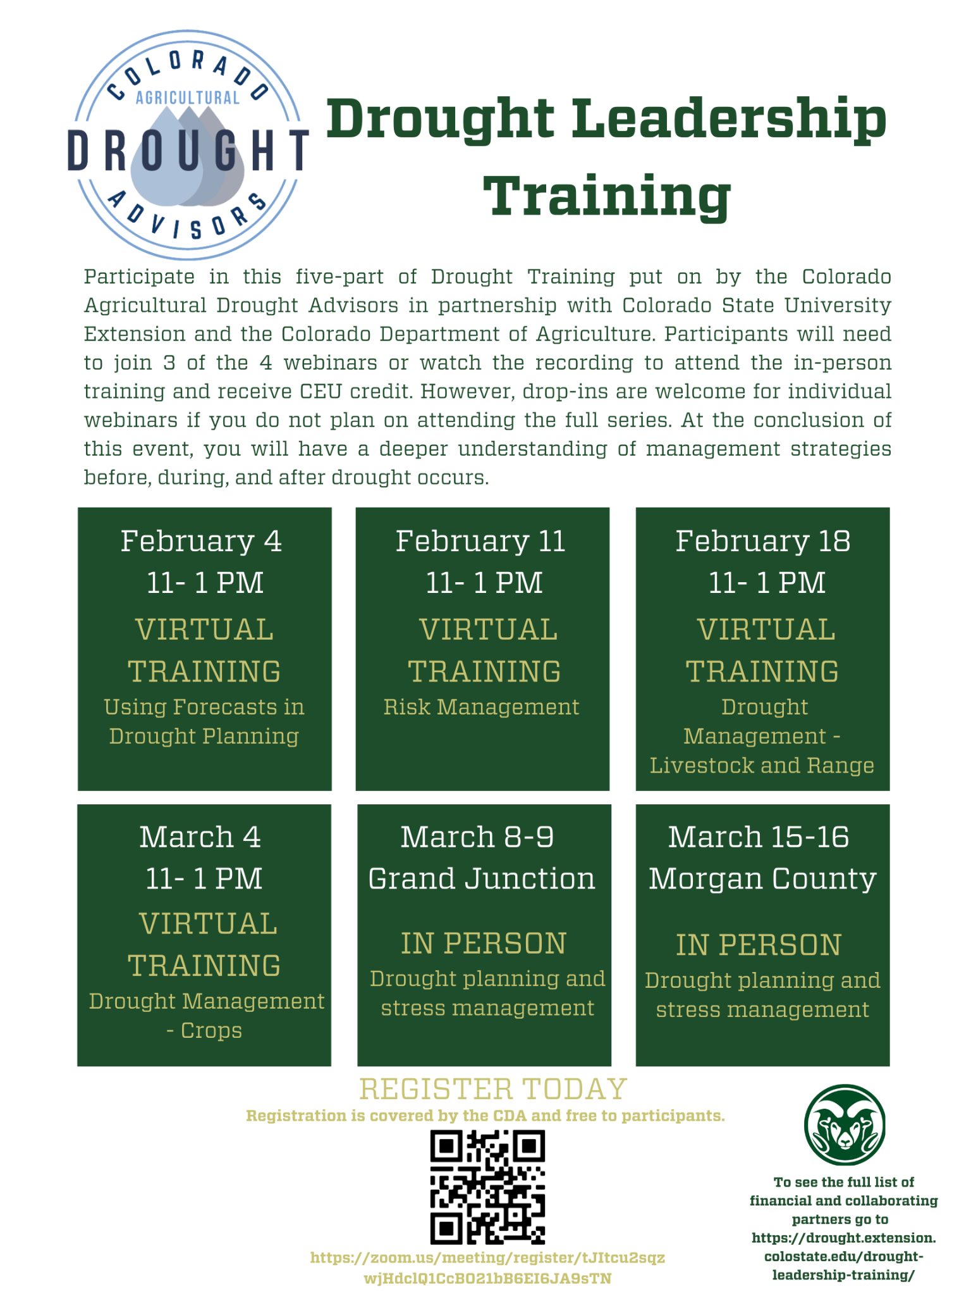
THANK YOU!
We will see you next week!
Virtual Training #3: Livestock and Range Drought Management
Moderated by Micaela Fenton
Virtual Training #4: Crops Drought Management
Moderated by Gus Westermann
In-Person Final Training: Drought Planning and Stress Management
West Slope - 3/8-3/9
East Slope - 3/15-3/16

