Slide 1
02.11.2022
Drought Leadership Training
Retta Bruegger | retta.bruegger@colostate.edu | (970) 988- 0043

Slide 2
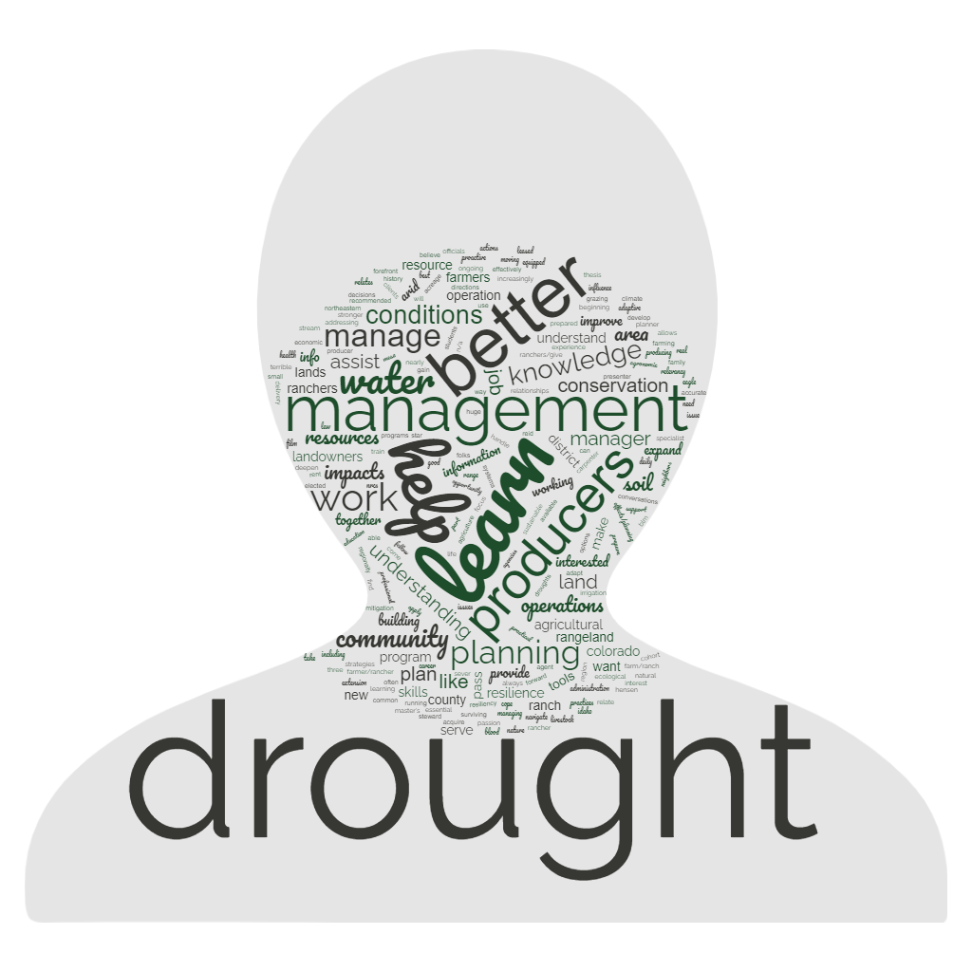
Why did you join today?
“To help prepare my operation for drought and serve as a resource for other producers”
“With increasingly common and severe drought we need to improve our tools”
“I am a professional rancher and land manager and am always having to manage and cope with drought conditions.”
Notes:
Why did people join slide
And registration info?
Relates to your job/ livelihood
To help prepare my operation for drought and serve as a resource for other producers
Learn drought strategies to apply working with producer who rent leased agricultural operations
With increasingly common and sever drought we need to improve our tools to effectively manage land in a sustainable way.
to learn how to manage lands in drought conditions
I have been through three terrible droughts in my career and I want to develop a better understanding of how to plan for them
I am a professional rancher and land manager and am always having to manage and cope with drought conditions.
Better able to understand drought and better able to communicate practices that can help
Prepare a drought plan for my ditch company
I’d like to be able to host local workshops on this topic.
I'd like to be able to talk to our producers about ways to better manage their livestock during and following drought
Helping my neighbors plan for changes
meet the goals that you have listed
CO
more resiliency and better preparation
Better grasp of how to move forward... In a drought aware manner

Slide 3
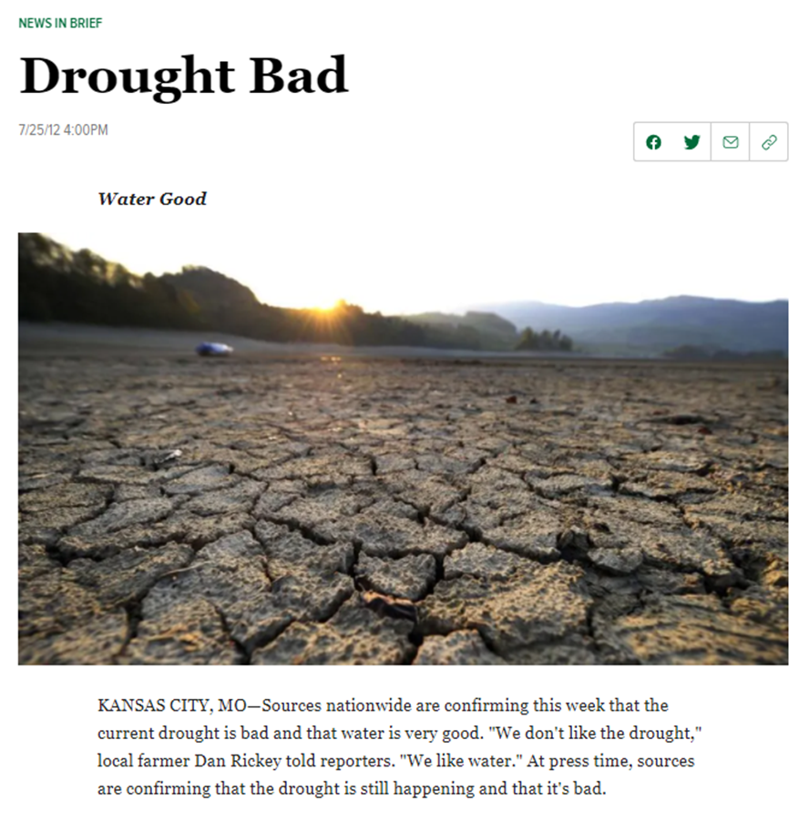
Drought: What we know
Can’t make it go away.
Can’t know what’s going to happen.
It’s bad.
Lots of tools tell us there is a drought.
Notes:
Drought is not a problem like other problems – it’s a circumstance not a problem.
So why is ‘planning’ an appropriate response rather than a ‘practice?’
Lots of people want to ‘solve’ drought – sell you a solution to drought
Adaptation is continuous; not discrete. Just because you did something different, doesn’t mean the drought will go away.

Slide 4
Notes:
Goals help define what's meaningful and help you stay focused

Slide 5
Elements of a Drought Contingency Plan
If..........
2
Then.........
Goals
1

Slide 6
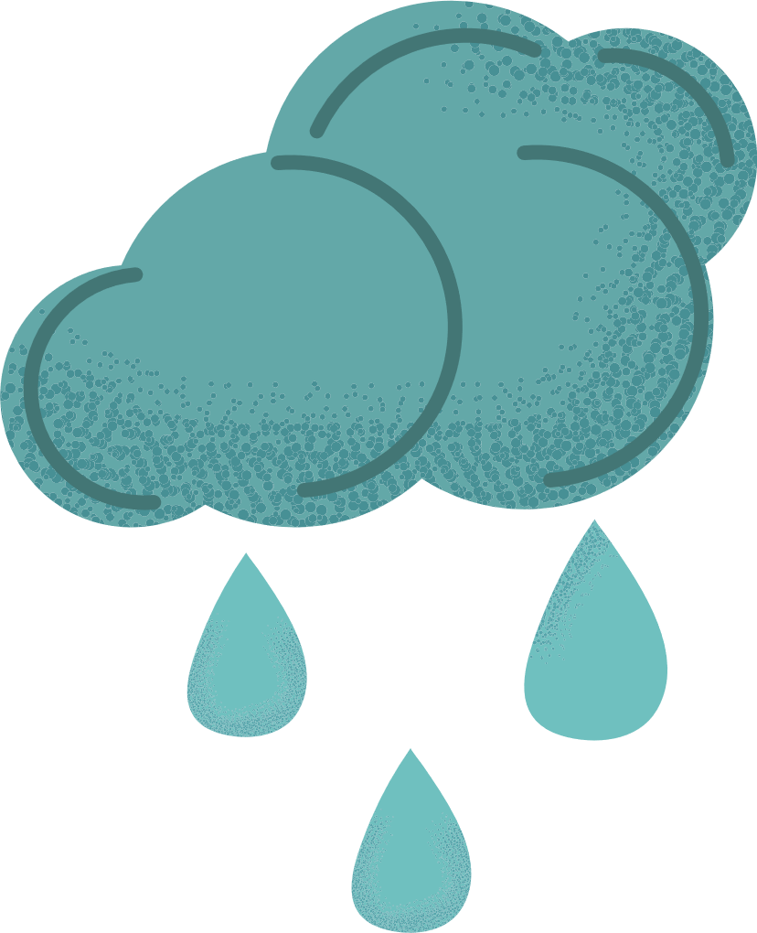
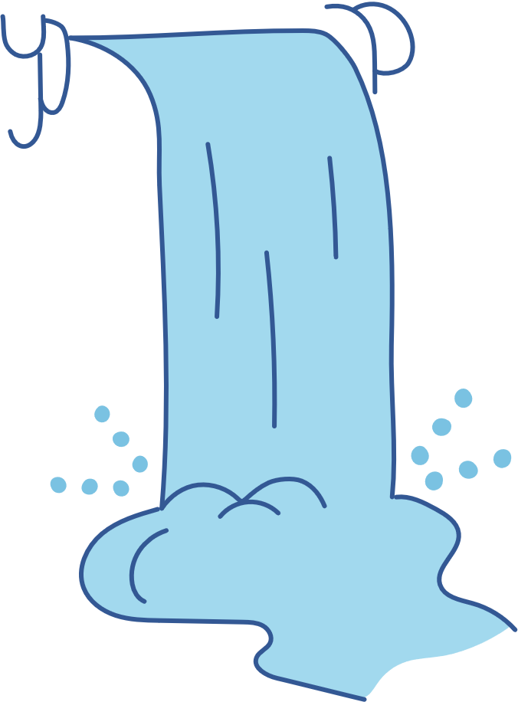
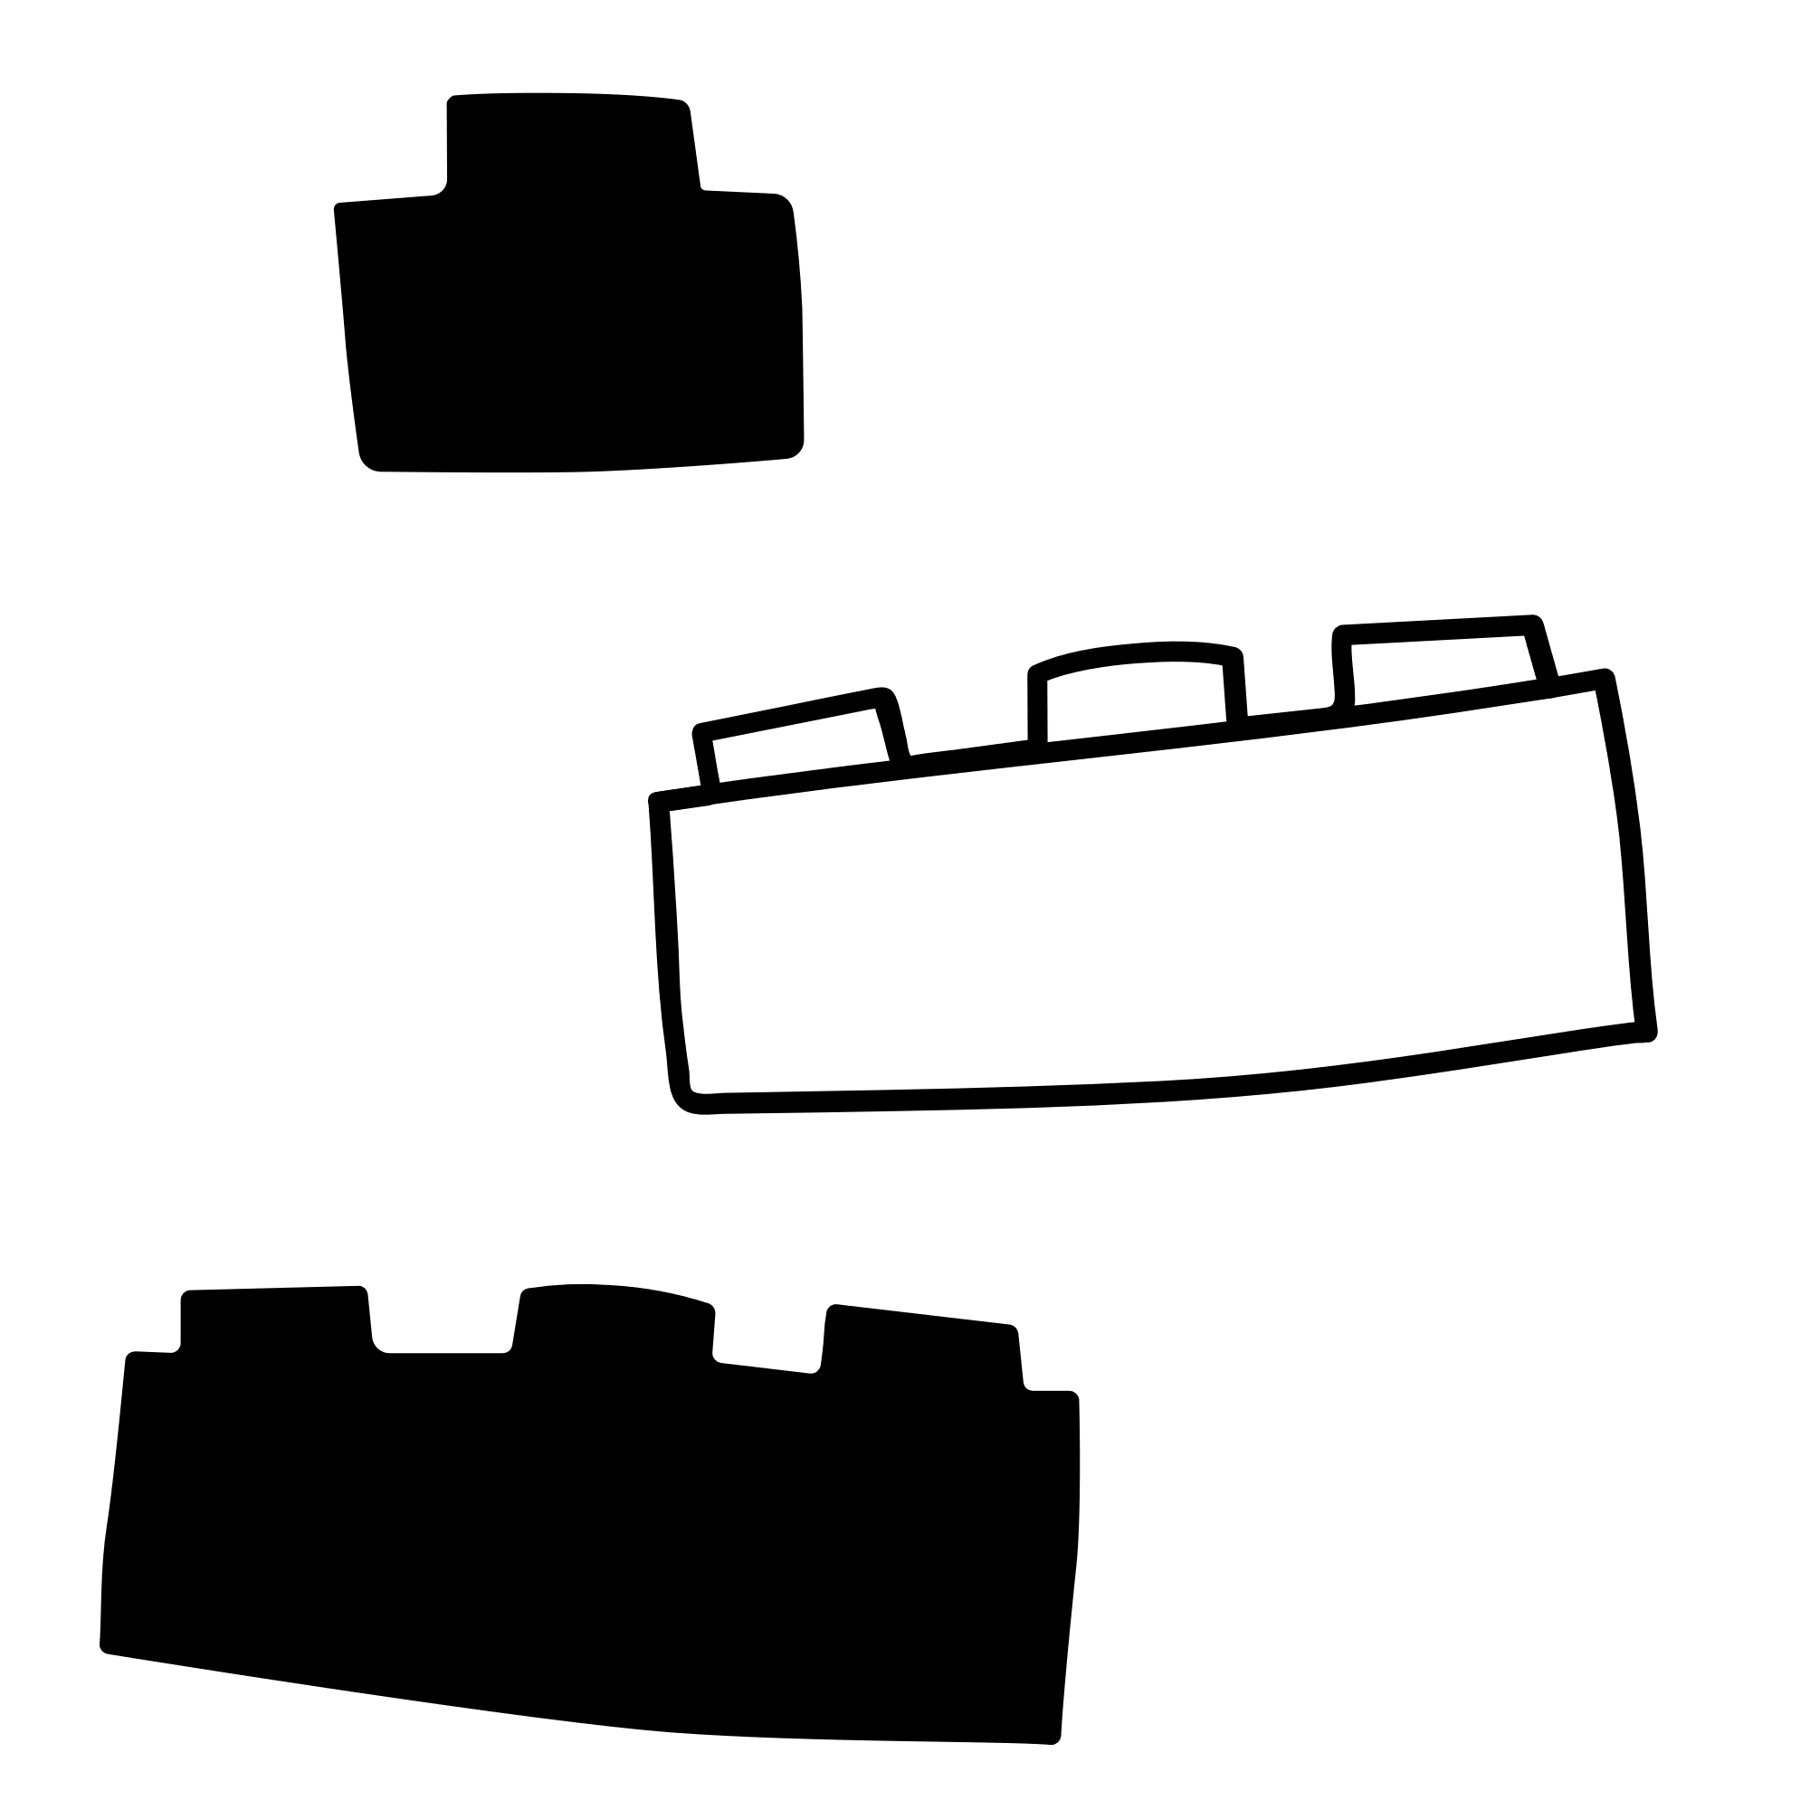
Elements of a Drought Contingency Plan
Goals
If..........
2
Then.........
1
Triggers & Scenarios
Strategies
April is warm and dry
Previous fall was dry
Projected runoff is 50% of average
My average production has decreased by 20%
Cull base herd by X%; Planned de-stocking
Crop change
Invest in future infrastructure
Create wildfire evac plan

Slide 7
Elements of a Drought Contingency Plan
If..........
2
Then.........
Goals
1
What is the the legacy you want to create?
Triggers & Scenarios
Strategies
What specific condition prompts a decision in a drought plan?
What management actions get you to your goals in drought?

Slide 8
Elements of a Drought Contingency Plan
If..........
2
Then.........
Goals
1
What is the legacy you want to create?
Triggers & Scenarios
Strategies
What specific condition prompts a decision in a drought plan?
What management actions get you to your goals in drought?
Last week’s webinar

Slide 9
Elements of a Drought Contingency Plan
If..........
2
Then.........
Goals
1
What is the the legacy you want to create?
Triggers & Scenarios
Strategies
What specific condition prompts a decision in a drought plan?
What management actions get you to your goals in drought?
This week’s webinar

Slide 10
So, what does a strategy look like?
Anticipate it.
Set critical dates for decisions.
Develop strategies to reduce risk.
Notes:
reduce stress

Slide 11
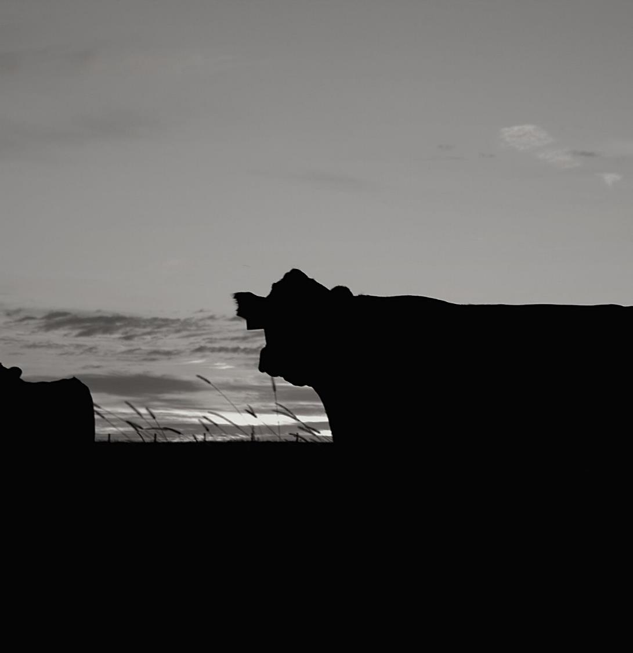
I don't need any more reminders it's dry
But it is a good reminder to act.

Slide 12
Drought: What we know
Can’t make it go away.
Can’t know what’s going to happen.
It’s bad.
Lots of tools tell us there is a drought.
Notes:
Drought is not a problem like other problems – it’s a circumstance not a problem.
So why is ‘planning’ an appropriate response rather than a ‘practice?’
Lots of people want to ‘solve’ drought – sell you a solution to drought
Adaptation is continuous; not discrete. Just because you did something different, doesn’t mean the drought will go away.

